Slide 1
Future State Processing DRAFT Collaborative Intelligence Storyboard 11/4/2014 – Version 1
Chris Argenta
cargenta@ara.com
Decision Systems Group Lead
Applied Research Associates, Inc.
Raleigh, NC
ARA Proprietary

Slide 2
I’m interested in new Apple products.
Notes:
Express an interest in some future state with high uncertainity…

Slide 3
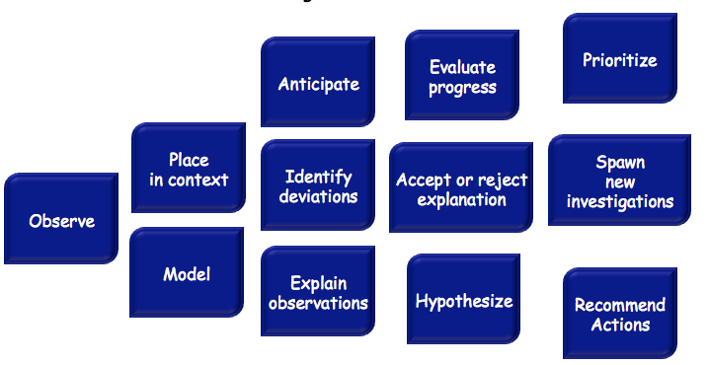
Collaborative Intelligence to seed via crowd-sourcing.
Focus options on the leading items: computer , television and watch.
In “I’m interested in new Apple products.” does “Apple” refer to: A) Fruit B) Computers
C) Other (what?)
Crowd opinion has not converged yet.
Unexpected peak in context suggestions for “watch” and “television”- add to options given.
What is your confidence that a new Apple Product might be a “watch” [or a “computer”]?
I’m interested in new Apple products.
Reject the fruity context, drop from options given.
Apple products include Mac, iPad, iPhone, Pies, Sauce
Contextual meaning of “Apple product” is bifurcating on computer and watch.
observe
describe
interpret
evaluate
decide
*Blue blocks from IBM’s SAFERPLANET Activity Elements

Slide 4
Collaborative Intelligence to seed via crowd-sourcing (part 2).
Focus options on the leading items “watch”
Crowd opinion has not converged yet.
Crowd opinion converged.
Crowd opinion recently changed significantly from previous trends.
What is your confidence that a new Apple Product might be a watch [or a computer] ?
A leaked photo of a watch makes it more likely that Apple’s new product is a watch.
Abandon low confidence “television” line of questioning.
Rumor of leaked photo graph of Apple watch.
Why might people have recently started to believe a new Apple product would be a watch?
observe
describe
interpret
evaluate
decide
*Blue blocks from IBM’s SAFERPLANET Activity Elements

Slide 5
Collaborative Intelligence to identify futures model.
If Apple released [or didn’t release] a Watch [or computer], what else might happen?
Focus crowd on the unstable (low confidence in model, not situation) and high risk aspects of model.
We have not yet converged on a stable model.. Keep going…
How would [factor] increase/decrease your belief that a new Apple product would be a “computer”?
[or “watch”]
What is the impact of patents from Apple on probability of watch? &
If there is a new watch product, what is the p(sales of ipad goes down)
What other factors might have influenced a new Apple product?
What is the risk associated with “sales of large screen iPads will go down”?
Are we converging on a risk model?
Identify risks/costs associated with potential futures.
There are patents from Apple about watch technologies.
Sales of large screen iPads will go down.
Generate list of factors for watch–list in observation.
Apple will release a watch (% confidence), which will result in iPad sales going down.
Android watches are being released.
Apple purchased Beats Audio.
Android watches suggests increase p(watch). Beats Audio has no strong correlation.
observe
describe
interpret
evaluate
decide
*Blue blocks from IBM’s SAFERPLANET Activity Elements

Slide 6
Reflect
Observe
Imagine
Apple patents for televisions
Apple releases Television
Apple patents for watches
Large screen iPad sales goes down
Apple releases Watch
Android releasing watches
Leaked photos
Apple patents for computer
Apple releases Computer
Apple = Computer Company
Beats Audio Purchase
Apple = Fruit

Slide 7
How a projector might Reflect,
Observe, and Imagine…
Projector
Understand bounds of interest
Future State Interest Criteria
Find Relevant Existing Knowledge
Establish Relevance to Interest
Historical
State Data
Focus Generation
Clarify Existing and Streaming Observations
Ontology / Domain Models
Prune &
Rank
Extrapolate Future States
Domain / Prediction Models
Prioritize Future States
Risk/Value
Models

Slide 8
How Collaborative Intelligence
might augment a projector…
Projector
Configure an query
Ask pool(s) what is relevant
Understand bounds of interest
Future State Interest Criteria
Find Relevant Existing Knowledge
Elicit model(s) of the context
Establish Relevance to Interest
Historical
State Data
Focus Generation
Clarify Existing and Streaming Observations
Ask about future given context model
Ontology / Domain Models
Prune &
Rank
Extrapolate Future States
Elicit model(s) about the future states
Domain / Prediction Models
Prioritize Future States
Collaborative Intelligence
could co-exist and possibly augment other automated projectors.
Risk/Value
Models

